Slide 1
PI-22 Review
Support for On-Premises: Progress Assessment
Lusaka Oct/Nov 2023

Slide 2
Workstream History
For reasons of efficiency, cost minimisation and convenience, much of the Mojaloop software development and testing process has been performed in public cloud infrastructure targeting cloud-native architecture.
Upcoming Mojaloop operating environments require private data centre infrastructure.
Efforts are ongoing to optimise the Mojaloop deployment and maintenance processes for private data centre scenarios.

Slide 3
Workstream Objectives
To make the process of deploying and maintaining Mojaloop switch software in private data centres reliable, quick, easy and cheap.
Enable starting small to minimise initial capex but with cheap unit cost to add capacity as traffic grows
No license fee technology in the tool set
Facilitate “carrier grade” security, reliability and resilience
Support well known, tried and tested infrastructure patterns

Slide 4
On Premises Workstream PI-22 Highlights
Hardware specifications recommendations produced; and being iterated to support more architectural options (start small & add cheap units of scale)
Secure OS layer (Kairos immutable Linux) tests ongoing:
Successful Kairos based K3s high-availability cluster bootstrap on bare-metal and virtualized via Hyper-V and VMWare (initially targeting Rwanda preferred profile)
Enhanced self-serve software layer install documentation in progress
Added microk8s as a 2nd K8s option (as well as K3s)
API Gateway Alternatives (+perf characterisation workstream):
Added Istio (K8s native option as ingress gateway)
Added Keycloak option as identity provider and JWT issuer
Using Istio + Keycloak to control API access
Added K6s instance as option for cluster deployments to facilitate the load testing effort (+perf characterisation workstream)

Slide 5
On Premises Workstream PI-22 Highlights
Community member Infitx providing their Mojaloop bare-metal test rack (grateful thanks!)
Deployment processes being tested and refined currently
Hypervisor and native
Performance testing under way
Reusing performance tests from performance characterisation workstream

Slide 6
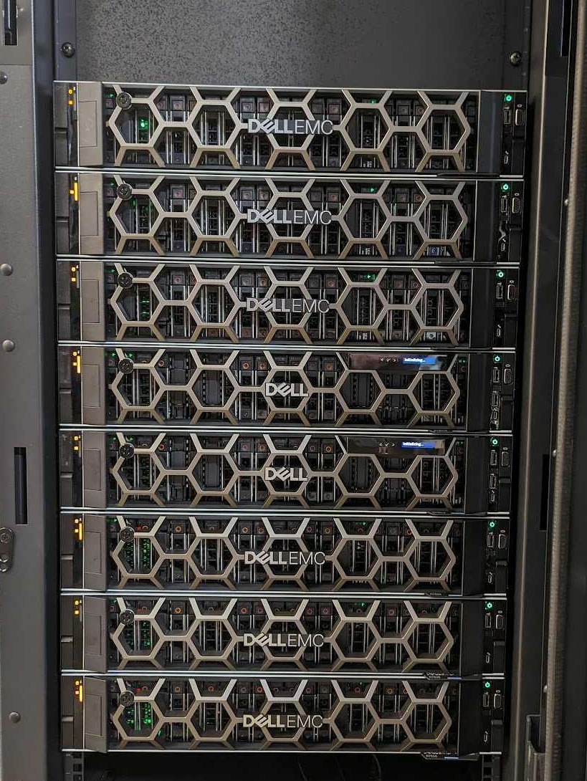
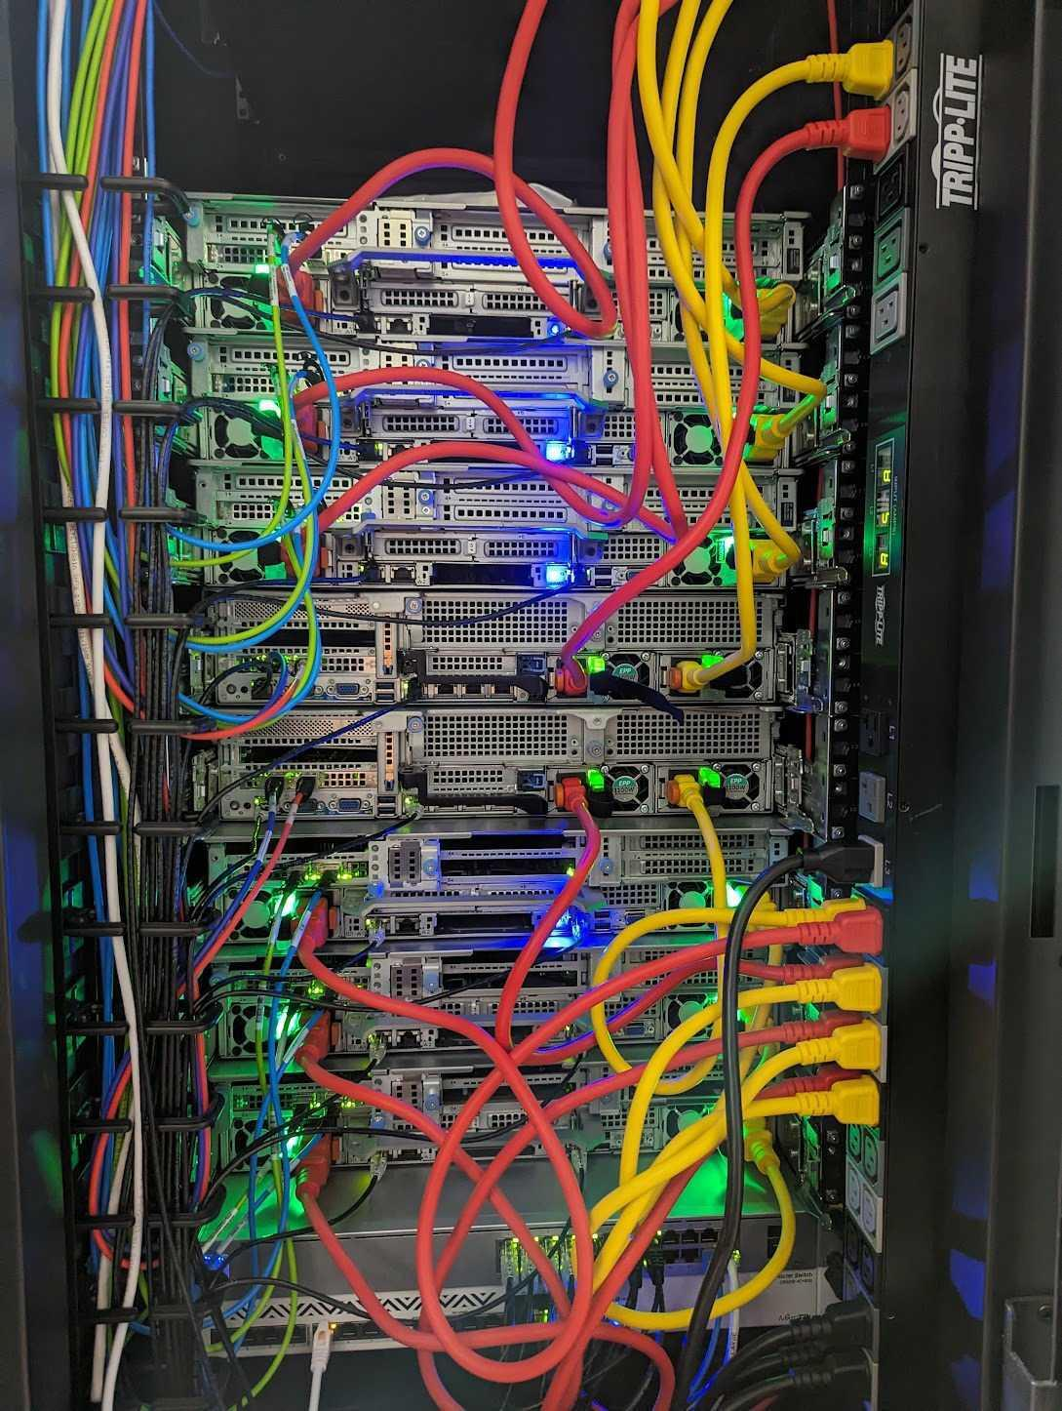
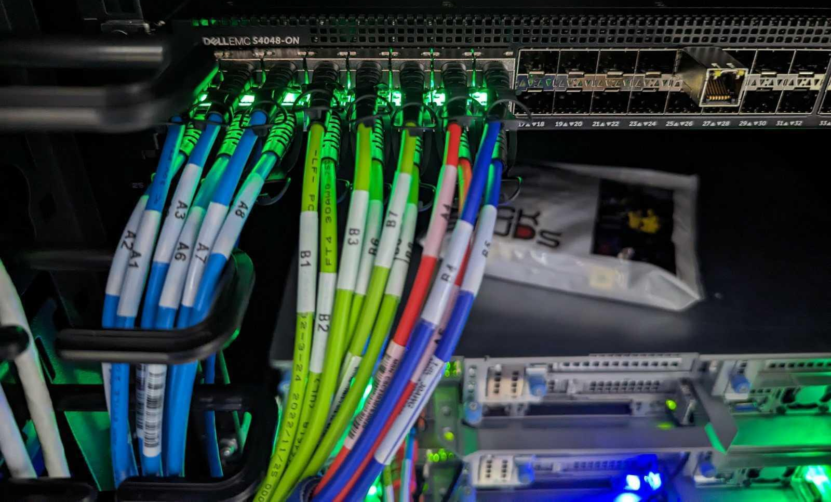
A Mojaloop “in the wild”...

Slide 7
On Prem Workstream Update
Next steps:
Continue HELM chart refactoring to allow simpler workload separation
Continue performance tests on bare-metal cluster
Continue to iterate installation and maintenance documentation
Support upcoming deployment in Rwanda
Further discussion on next steps will happen this Friday. All delegates are welcome to join the discussion to shape the future of this workstream.

Slide 8
Reach out to participate
Email: james.bush@mojaloop.io
Mojaloop Slack: @James Bush

